Slide 1
CYBERBULLYING & VIRTUAL SAFETY 101 FOR PARENTS
Mrs. Chew-Render, Counselor

Slide 4
Please post your questions in the CHAT BOX.

Slide 5
TOPICS OF DISCUSSION
What is cyberbullying?
Examples of cyberbullying
Cyberbullying and the law
How you can prevent cyberbullying

Slide 6
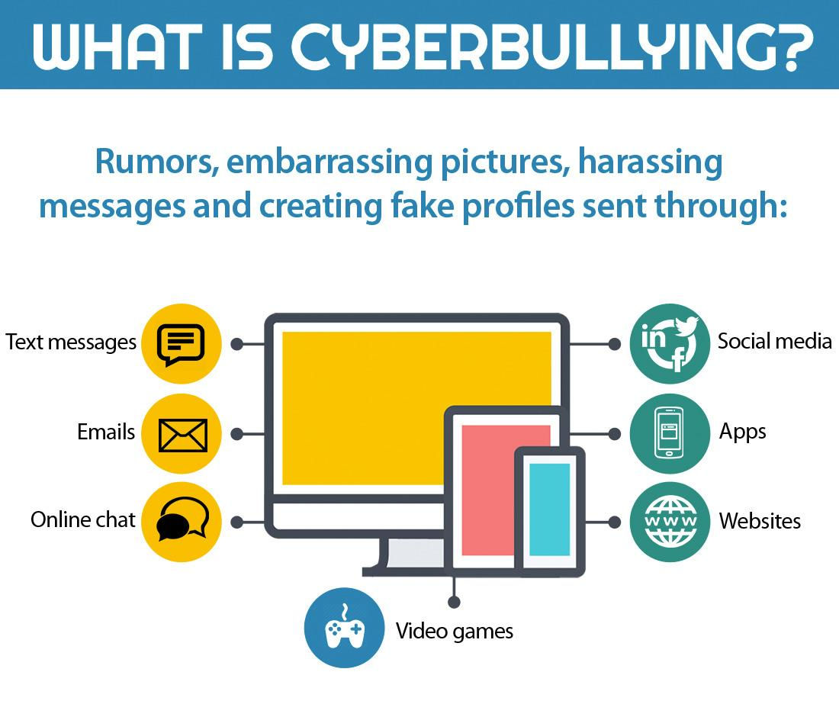
Intentional
Power play
Repeated

Slide 7
WHAT IS CYBERBULLYING?
4. “Cyberbullying” means: The term also applies to acts of cyberbullying which occur through the use of electronic communication, whether or not such electronic act originated on school property or with school equipment, if the electronic communication (1) is directed specifically at students or school personnel, (2) is maliciously intended for the purpose of threatening the safety of those specified or substantially disrupting the orderly operation of the school, and (3) creates a reasonable fear of harm to the students' or school personnel's person or property or has a high likelihood of succeeding in that purpose. For purposes of this Code section, electronic communication includes but is not limited to any transfer of signs, signals, writings, images, sounds, data or intelligence of any nature transmitted in whole or in part by a wire, radio, electromagnetic, photo electronic or photo optical system. Page 43 of the CCPS Student Handbook

Slide 8
DON’T SHARE PASSWORDS
POPULAR

Slide 9
CYBERBULLYING AND THE LAW
16-12-100.2. Computer or electronic pornography and child exploitation prevention (a) This Code section shall be known and may be cited as the "Computer or Electronic Pornography and Child Exploitation Prevention Act of 2007." (b) As used in this Code section, the term: (1) "Child" means any person under the age of 16 years. (2) "Electronic device" means any device used for the purpose of communicating with a child for sexual purposes or any device used to visually depict a child engaged in sexually explicit conduct, store any image or audio of a child engaged in sexually explicit conduct, or transmit any audio or visual image of a child for sexual purposes. Such term may include, but shall not be limited to, a computer, cellular phone, thumb drive, video game system, or any other electronic device that can be used in furtherance of exploiting a child for sexual purposes;

Slide 10
https://www.youtube.com/watch?v=BKn1fnizNOk

Slide 11
BULLIES…
Bullies suffer too
They have learned the behavior at home
They may lack attention from home
They have been bullied before
They may suffer from low self-esteem
We will work with students. Third time may result in a tribunal

Slide 12
VIRTUAL SAFETY
Taken from the Henry County police department Facebook post: Students who stream pornography during online class sessions, the post warned, “could face manufacture and distribution of child pornography charges, child molestation charges, and have to register as a sex offender. This is not a joke. We’re seeing the students logging in on their phones and sharing their screens from there, or just holding other screens up to the webcam.”

Slide 13
HOW CAN YOU PREVENT CYBERBULLYING?
Let someone know. Talk to your child about his/her day.
Block or delete the person sending negative messages. Remember, it takes two to engage.
Limit your child’s access to technology.
Monitor your child’s phone and social media pages.
Encourage your child NOT to share passwords with friends.
Let someone know if your child is the bully.

Slide 14
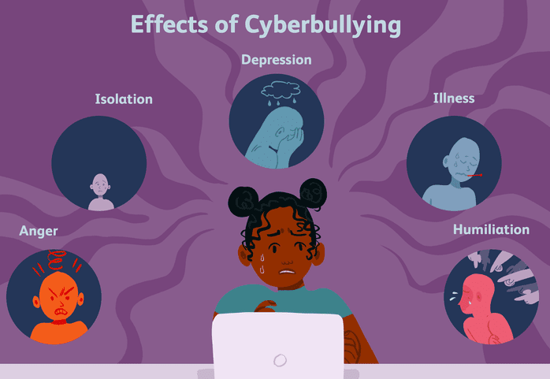

Slide 15
RESOURCES

